Slide 1
Class 2 -
Excerpts and Quotes from People during the Arab Spring

Slide 2
Overview
The quotes can be shared to the class and completed together, in stations, or in the small groups formed on Day 1.
For each quote/excerpt used, ask students to share how it has impacted their beliefs about the essential question: How can individuals and groups change society?

Slide 3
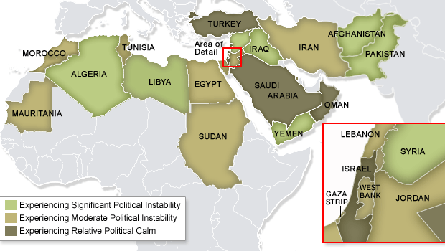
Arab Spring Map: Option 1
Notes:
Source: http://www.lilithnews.com/2011/12/2011-year-of-protester.html.

Slide 4
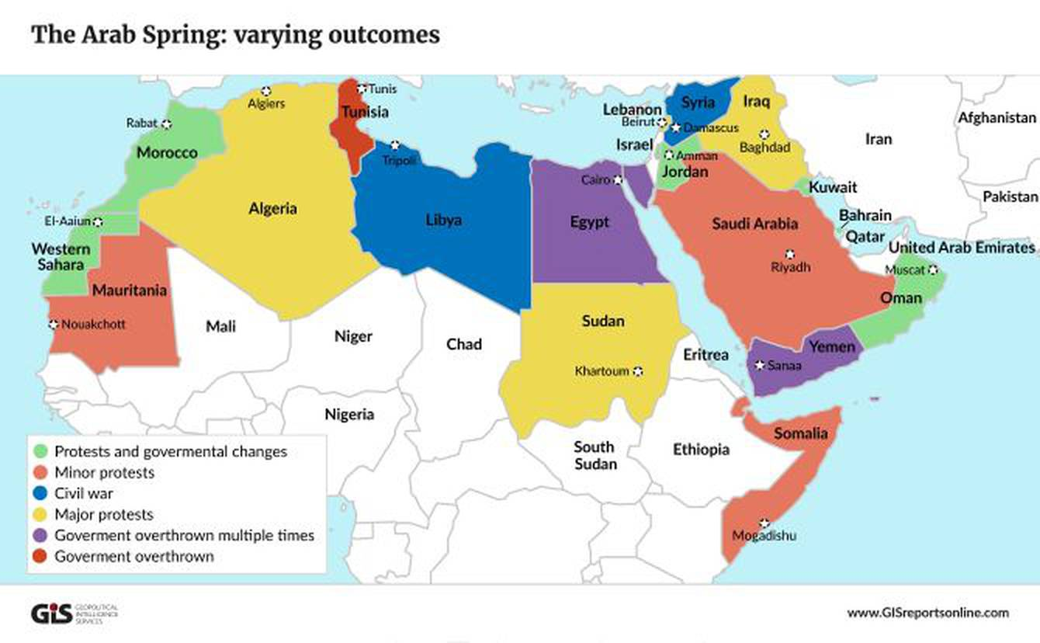
Arab Spring Map: Option 2
Notes:
Source: https://lotusarise.com/inshorts/arab-spring-upsc/

Slide 5
Quote/Excerpt 1
The phrase "the people want to bring down the regime" has been the cry from Morocco to Bahrain. It was the phrase that brought down Egypt's Hosni Mubarak in February.
"The phrase came from the oppression and injustice that Tunisians felt and the division that Ben Ali's regime created among Tunisians. It expresses the idea that the people are united in the desire to bring down this regime that tries to separate us.”
Salah Attia, journalist
How does this information impact your beliefs about the Essential Question: How can individuals and groups change society?

Slide 6
Quote/Excerpt 2
“The word Tahrir means liberation. It is a word that speaks to that something in our souls that cries out for freedom. And forevermore it will remind us of the Egyptian people — of what they did, of the things that they stood for, and how they changed their country, and in doing so changed the world.”
President Barack Obama, in Remarks by the President on Egypt (February 2011)
How does this information impact your beliefs about the Essential Question: How can individuals and groups change society?

Slide 7
Quote/Excerpt 3
Music translation:
“President of the nation, your people have died.
Many people eat from the garbage and you are seated as you see what is going on in the country misery everywhere and people have not found a place to sleep.
I am speaking in the name of the people who have been victimized and trampled over.”
Hameda Ben Amor “El General” Tunisian Rapper
How does this information impact your beliefs about the Essential Question: How can individuals and groups change society?

Slide 8
Quote/Excerpt 4
“If the young men stay in the Tahrir-style Squares of Egypt, Tunisia, Libya, Morocco and Syria in such a state of want, their battle for power…will be a losing one. They will surely fail without the participation of young Arab women, who have truly begun work that is organized, bold and qualitatively new. They are active in all of those countries as well.”
Raghida Dergham, journalist.
How does this information impact your beliefs about the Essential Question: How can individuals and groups change society?

Slide 9
Quote/Excerpt 5
“Yemen police fire on protesters: One person dead and dozens injured”
“#Yemen declares a state of emergency in the country.”
“Saudi king to announce reforms: King Abdullah expected to announce government reshuffle and anti-corruption measures.”
“Protestors stage rare demo in Syria…call for freedom in rare display of dissent.”
Series of Twitter posts by Al Jazeera in 2011
How does this information impact your beliefs about the Essential Question: How can individuals and groups change society?

