Slide 1
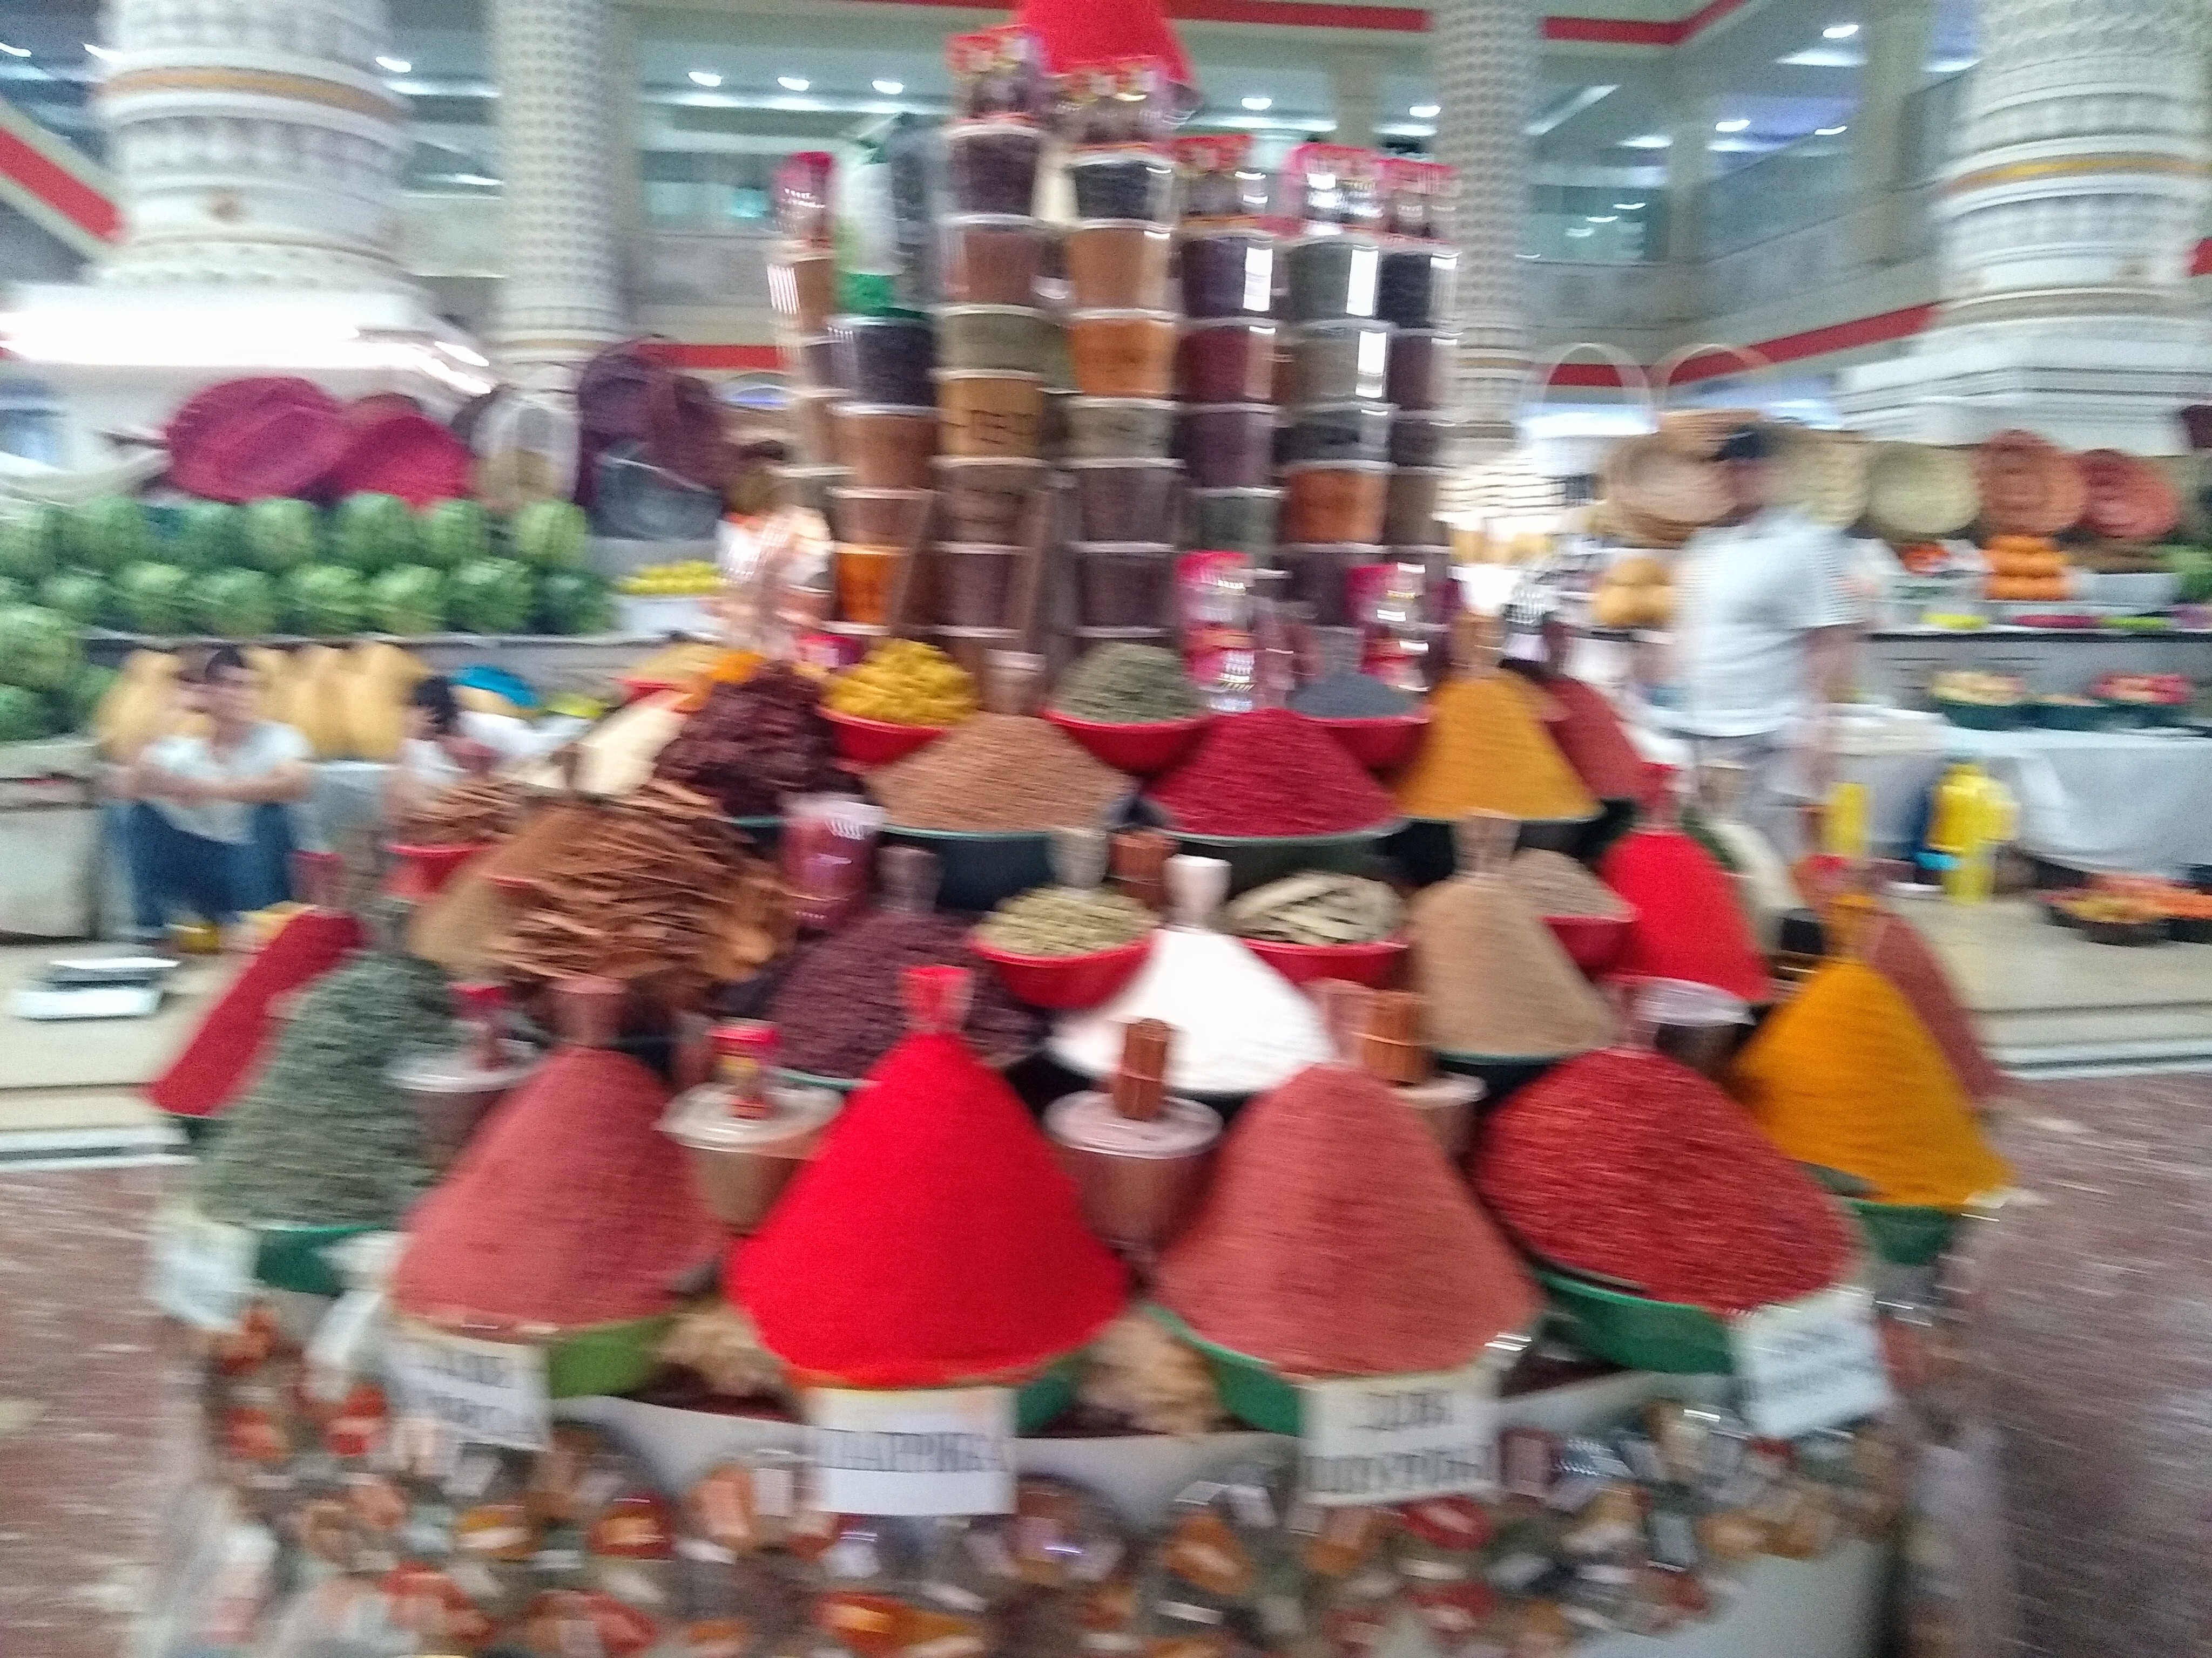
Spices and Herbs of Uzbekistan: An Olfactory journey through Central Asia
Mickey Marsee, PhD
Chandler-Gilbert Community College
Mickey.Marsee@cgc.edu

Slide 2
Day 1: What’s that smell? The role of smell in history and culture
Objectives:
Access prior knowledge of smell observation and connection to memory
Identify role of smell in culture/memory
Discuss and evaluate the concept of smell in culture

Slide 3
Group Activity: Rank these aromas¹
(5 mins) In pairs, rank these aromas with your partner. Put the best aromas at the top and explain/discuss your choices.
  coffee
  freshly baked bread
  popcorn
  the countryside
  banana
  Axe body spray
  Air after rain

Slide 4
Group Activity continued…
(5 mins) In groups of 4, rank these aromas. Put the best aromas at the top and explain/discuss your choices. Select a group representative to share with the rest of the class.
  coffee
  freshly baked bread
  popcorn
  the countryside
  banana
  Axe body spray
  Air after rain
(5 mins) Group sharing.

Slide 5
Smell: An underdeveloped sense?
"A great many Things have been said of Smells," observed the late-seventeenth century Italian physician Bernardino Ramazzini, but "a particular and exact of History 'em is yet wanting."
This was still the case nearly three hundred years later when Roy Porter wrote his foreword to the English translation of Alain Corbin’s The Foul and the Fragrant, the work that more than any other wafted odor into modern historical consciousness.
"Today's history," Porter declared, "comes deodorized." "How many historians," he continued, "have given us the smell of previous societies? Researchers have been all too silent, repelled, it seems, by modern hygienic sensibilities even from contemplating the stench of the past.” (Jenner 2011)
Discuss: Many researchers claim that smell is the most underdeveloped sense in U.S. culture. What do you think?

Slide 6
Smell: An underdeveloped sense?
What discoveries did we make in our aroma ranking?
What role does smell play in our everyday experiences? In our memory and emotions?
Psychological studies find not only that information derived from one sense strongly influences what is perceived by another, but also that perception is usually based upon the correlation of "multisensorially determined sensations” (Jenner 2011)

Slide 7
Smell’s powerful psychological and cultural role might be learned
Scientific American article (2002): Studies with children and cross-cultural research provide strong evidence that responses to odors are learned through association.
  Odor learning begins before birth, when flavor compounds from the maternal diet get incorporated into amniotic fluid and are ingested by the developing fetus.
  In studies where mothers consumption for distinctive smelling substances such as garlic, alcohol or cigarette smoke were monitored during pregnancy, it was found that their infants preferred these smells compared to infants who had not been exposed to these scents.
  These early learned preferences also influence food and flavor preferences in later childhood and even adulthood. [Note that flavor is produced primarily by odor; taste contributes only the sensations of salt, sour, sweet, bitter and savory.]
Feeding, in addition to providing nutrition, is an opportunity for close physical contact and emotional bonding between mother and child. Thus, the role of emotion is clearly evident in associative learning in a food context. Other examples where infants experience cuddling in conjunction with incidental odors like perfume have shown that these incidental scents then become better liked (Herz 2002)

Slide 8
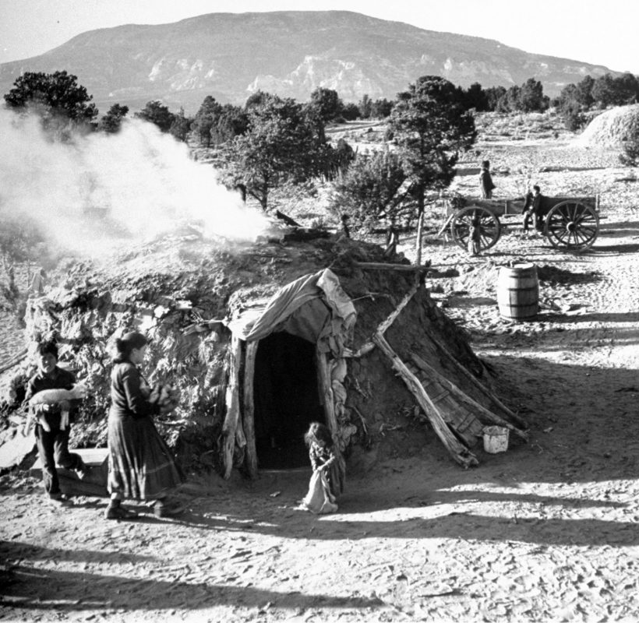
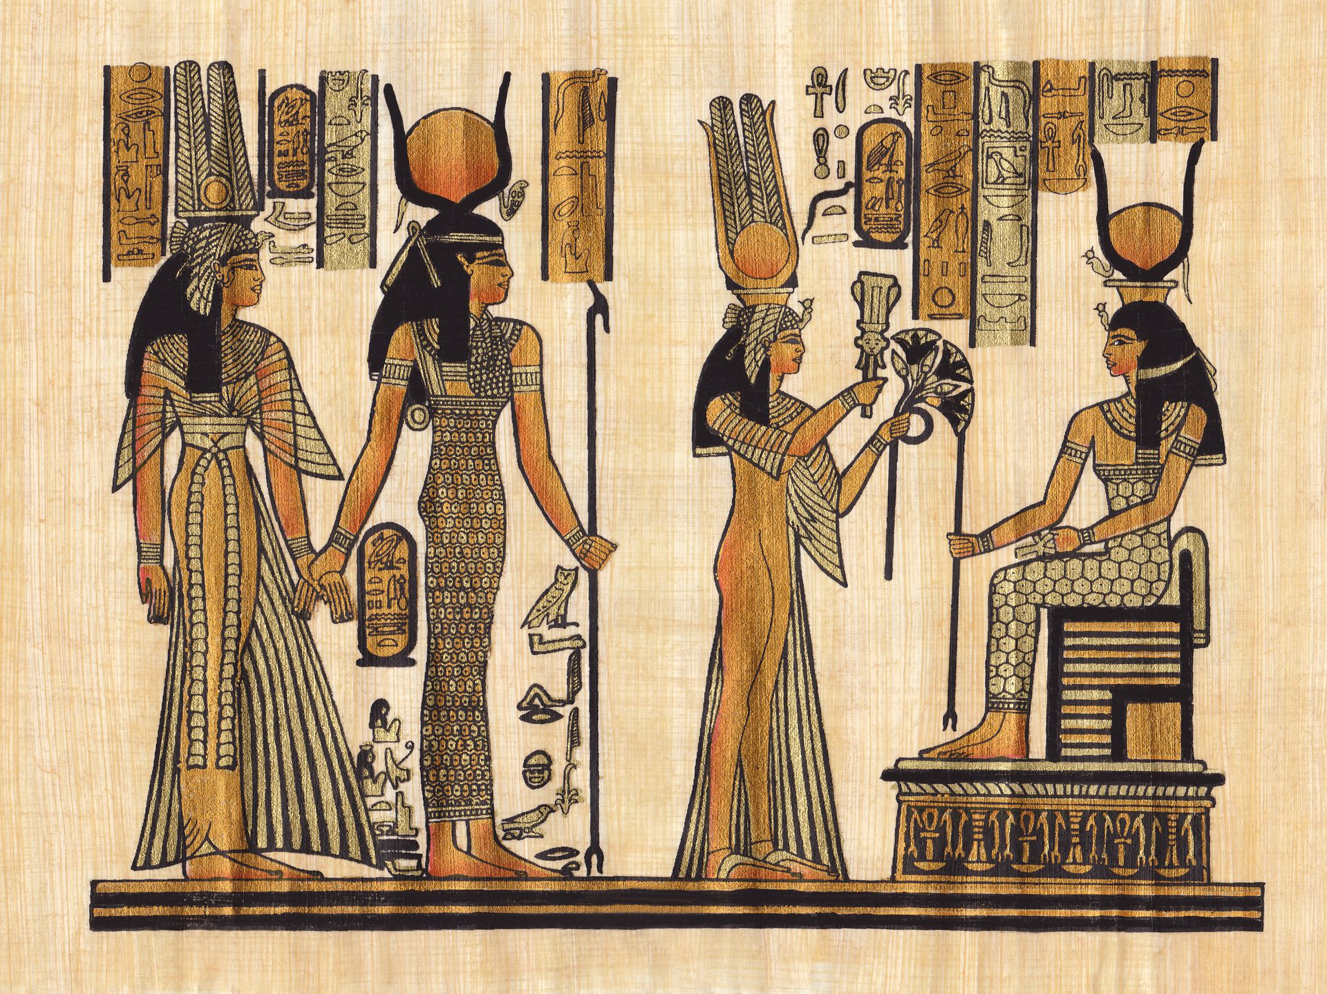
Role of Smell in History
Ever wonder what Cleopatra might have smelled like?
Or a Navajo camp site in the evening?
A British Tobacco shop in the 1800s?
Or the Gettysburg Battlefield in the Civil War?
Historians, sociologists and anthropologists have recently begun to work with smell history.
As explained by Cecilia Bembibre* and Matija Strlič in their 2017 article, “The Smell of Heritage:”
  …odours play an important role in our daily lives: they affect us emotionally, psychologically and physically, and influence the way we engage with history…. In the heritage context, experiencing what the world smelled like in the past enriches our knowledge of it, and, because of the unique relation between odours and memories, allows us to engage with our history in a more emotional way
Leonard McCombe The LIFE Images Collection/Shutterstock
CREDIT: BRAVO1954 / GETTY IMAGES

Slide 9
Group Activity² Think/Pair/Share: Reflecting on the role of Smell History
(5 mins) Think to yourself and record:
  What do you think of when you hear the word “smell”?
  What do you think of your smells?
  How do homes smell differently? How do countries smell differently?
  What does the 21st century smell of?
  What images are in your mind when you hear the word 'historic’?
  What do you think of the idea of historic smells?
  Do you think the past smelled more or less fragrant than today?
  Which smells today do you want to become history?
  What century would you like to smell?
  Can digital information recreate a smell?
  What do you think of the idea of watching a smell-o-vision?
  What questions would you like to ask the researchers about the history of smell or about the impact of smell?
(5-7 min) Share with partner
(10 mins) Share out with class
2. Adapted from Breaking News English Lesson: Historic Smells (https://breakingnewsenglish.com/2011/201119-historic-smells.html)

Slide 10
Homework
Using the articles listed below, write a 250-300 word response to the question: What role does smell play in understanding history/culture?
Readings:
Bembibre, C., Strlič, M. Smell of heritage: a framework for the identification, analysis and archival of historic odours. Herit Sci 5, 2 (2017). https://doi.org/10.1186/s40494-016-0114-1
Jenner, M.S.R. (2011). Follow Your Nose? Smell, Smelling, and Their Histories. The American Historical Review, 116(2), 335–351. http://www.jstor.org/stable/23307699
Herz, R.S. (2002, 11 Nov). Do scents affect people's moods or work performance? Scientific American. https://www.scientificamerican.com/article/do-scents-affect-peoples/

Slide 11
Day 2: Experiencing smell of Uzbekistan
Objectives:
Review role of smell in understanding or accessing culture
Describe a smell experience
Identify key spices and herbs of Uzbekistan
Introduce role of spices in historical trade in Central Asia/Silk Road

Slide 12
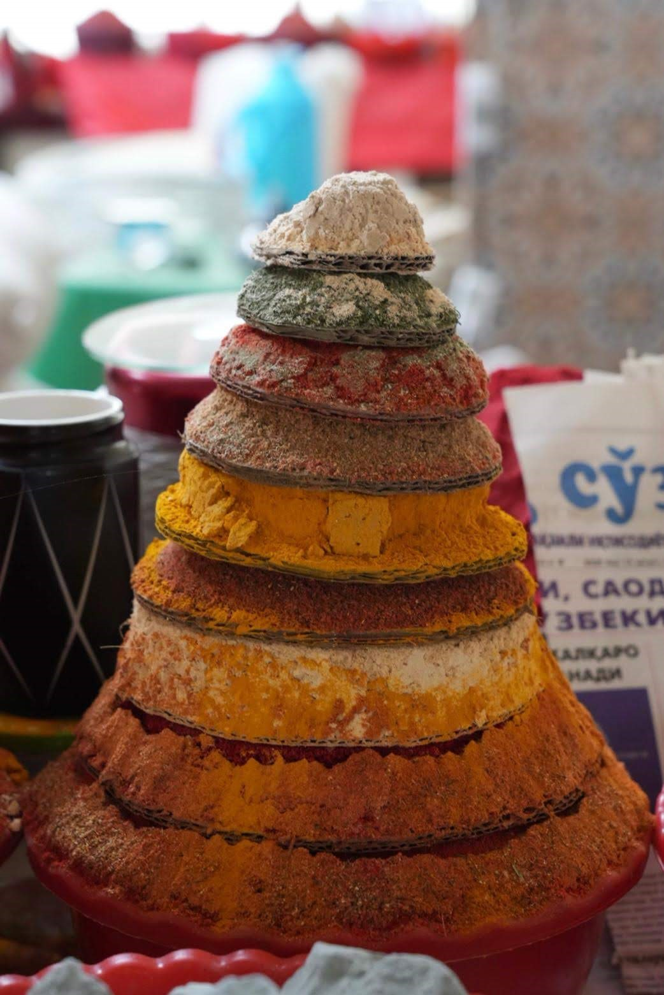
Smells: Seasonings, Spices, Herbs
Much of what we identify when it comes to smell is from food and cooking.
Why is this? (Refer back to homework readings)
Food is a necessity, and, in previous centuries, when weary travelers were looking for places to stay, most cultures took very seriously the idea of hospitality – providing shelter, food, and drink to a visitor with the idea that the hospitality is returned if they are ever in a similar position.
Food and cooking is also a popular way for cultures to communicate their welcome to visitors today. Cross-cultural experiences often begin with that.
What makes food unique to a culture or place (or even time) is the seasonings used in the cooking, whether those are herbs or spices. These also provide most of the scent (as well as flavor) of the food.
So spices and herbs play a very long and important role in our smell sensory experiences.
Artful display of spices in Uzbekistan market. Credit: Andrew Guier

Slide 13
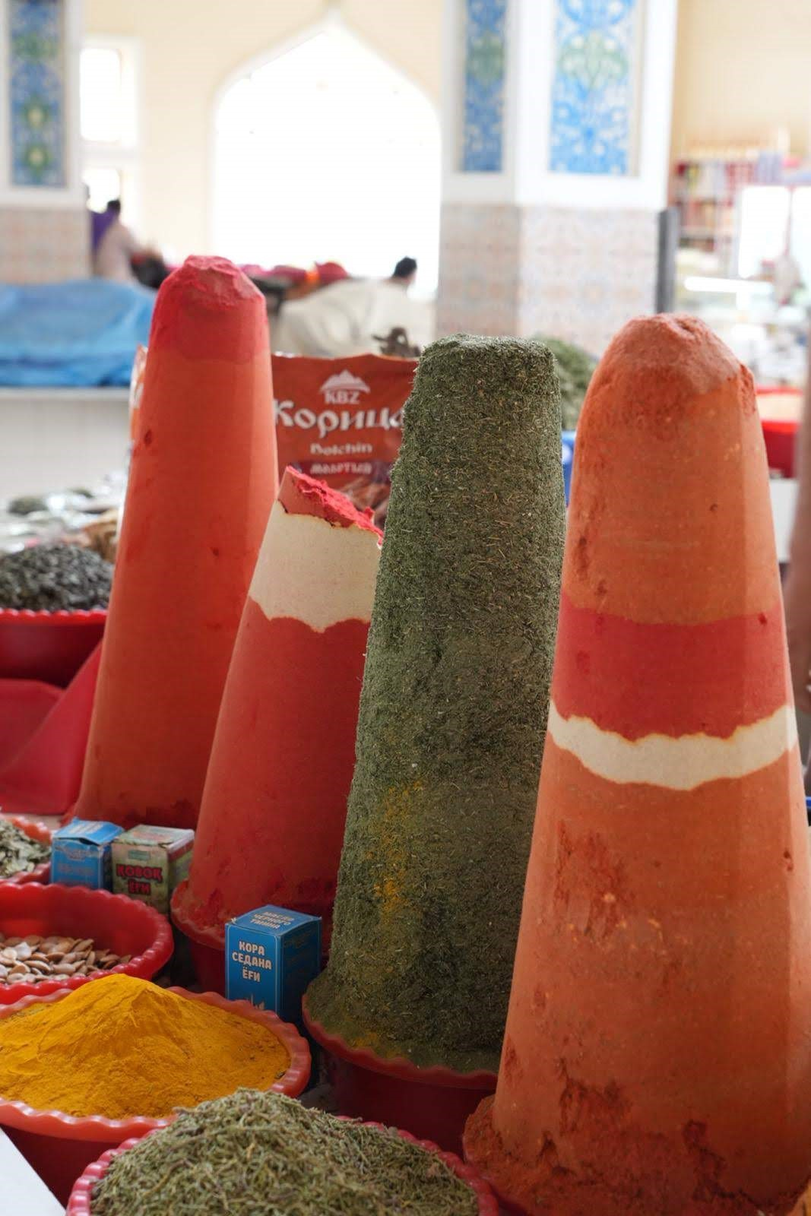
Those innocent spice jars sitting in your cupboard don’t do much to reveal their incredible history. But did you know that nutmeg was once worth more by weight than gold? That in the 16th century, London dockworkers were paid their bonuses in cloves? That in 410 AD, when the Visigoths captured Rome, they demanded 3,000 pounds of peppercorns as ransom? (https://silkroadspices.ca/pages/history-of-the-spice-trade)
Spice Bazaar. Bukhara. Uzbekistan Credit: Andrew Guier

Slide 14
Spices/Herbs: Historical Context
From the regal orange pistils of saffron to the warm, woody bark that rendered cinnamon, they made food memorable and delicious. The fact that they came from faraway places added value. Exotic spices evoke foreign lands and stir the imagination. When the nobility lavished them by the handful on their food, they might as well have been sprinkling their dishes with gold. (Daniel Patterson, “Spices, Culture, and the value of Cuisine”)
It’s hard to imagine, but spices have played an enormous role in global history. Central to almost all aspects of life:
health/medicine,
beauty (cosmetics and perfume and dyes),
spiritual (incense for example),
and in food/cooking.

Slide 15
Spice trade: A long history
Over 4,000 years ago, traders from China, Central Asia, the Middle East, and Eurasia established trade of many resources. One of the most costly and dear resources was spice.
The value of the spices were extraordinarily high and were sometimes desired over money.
Most of this trade happened along what is referred to as the Silk Road, which was comprised of several “roads” or routes from China to Greece/Rome.
Central Asia played an important role in this trade route as the center point, hosting many of the trade bazaars.
Uzbekistan (particularly Samarkand and Bukhara) played key roles.
Notes:
In its day, the spice trade was the world’s biggest industry: it established and destroyed empires, led to the discovery of new continents, and in many ways helped lay the foundation for the modern world.
Spices, which today are inexpensive and widely available, were once very tightly guarded and generated immense wealth for those who controlled them. The spice trade began in the Middle East over 4,000 years ago. Arabic spice merchants would create a sense of mystery by withholding the origins of their wares, and would ensure high prices by telling fantastic tales about fighting off fierce winged creatures to reach spices growing high on cliff walls.

Slide 16
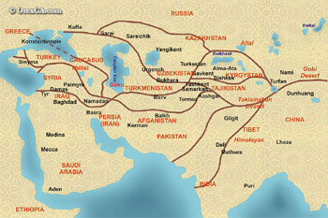
Map of the Silk Road Trade Routes

Slide 17

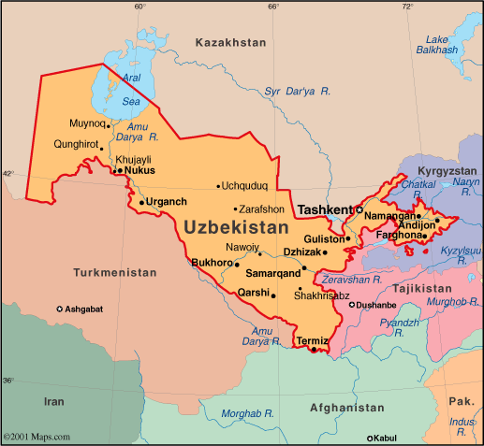
A little about Uzbekistan
A former country in the Soviet Union, Uzbekistan establish its new Republic in 1991.
Considered part of Central Asia, it is an ethnically and linguistically diverse country with an ancient history (Official languages include Uzbek, Tajik (a form of Persian), Russian, and English)
Known for its mosques, madrassas, and minarets as well as its hospitality
Music in Uzbekistan: https://youtu.be/-Sfdw3GjgFU
https://pin.it/3FHFTPm

Slide 18
Hidden Slide to students: List of smells
Mark the envelopes with a letter or number so that students do not have the name of the item they are smelling.
After the class discussion and seeing if students can identify any of the items correctly, provide a “key” for the envelopes

Slide 19
Activity: Smell Experience of Uzbekistan
(20 mins) Part 1: Smell Experience
At your table, you will find unlabeled envelopes of different spices and herbs from Uzbekistan.
On your own, take an envelope and carefully smell the contents. Take your time, you can close your eyes, and even smell it multiple times.
Record your impressions: can you identify the spice/herb? What does it smell like? What does it remind you of? Is it pleasant? Why or why not? What other impressions does it make on you?
After you finish one envelope, you can begin the next. You may choose to smell the coffee envelope in-between to “clear” your nose.
(20 mins) Part 2: Class Discussion
Notes:
The class discussion would also be a good time to work on identifying descriptive words and bringing students back to what they read for homework about scent and memory, psychology, and culture.

Slide 20
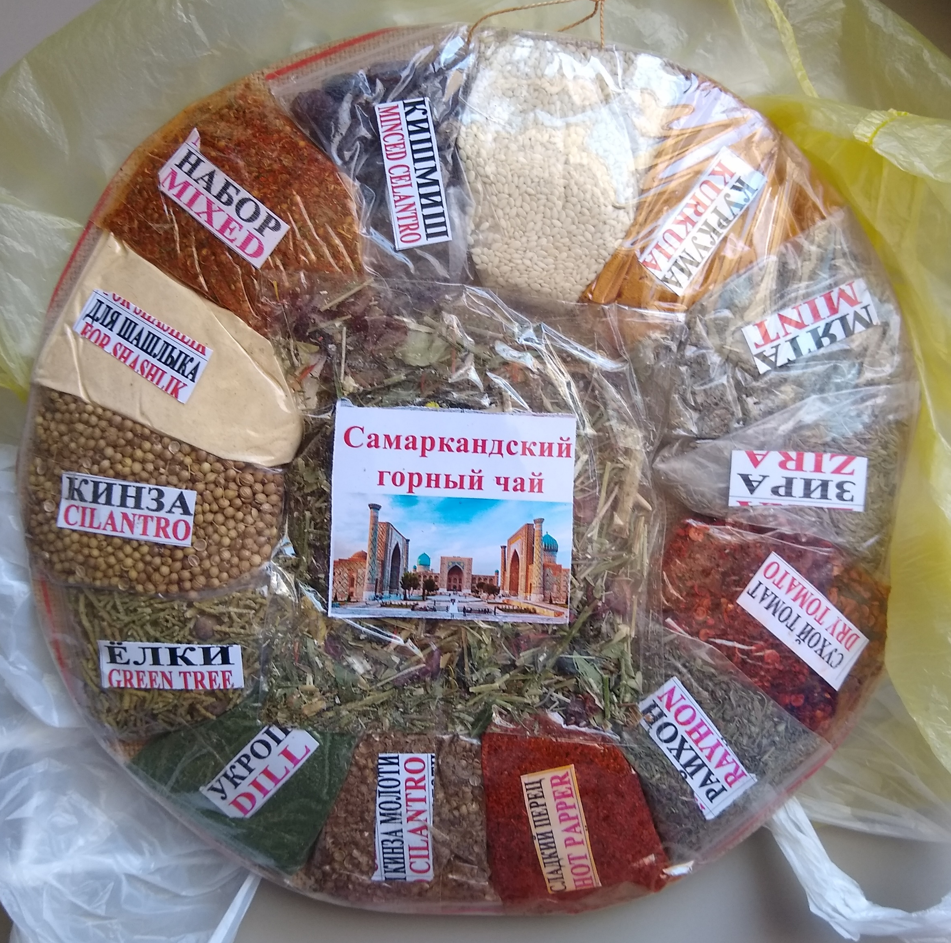
Commonly used Uzbekistan Spices and Herbs
Spices include black pepper, black cumin, barberries, coriander, bay leaf, and sesame seeds.
Herbs include cilantro (fresh coriander), dill, parsley, and basil.
Most spice merchants create their own blends of mixed spices for specific dishes like Plov (Pilaf), kabobs, and even tea.
Image: Sample packet of spices from Bazaar in Tashkent, Uzbekistan
Credit: Mickey Marsee

Slide 21
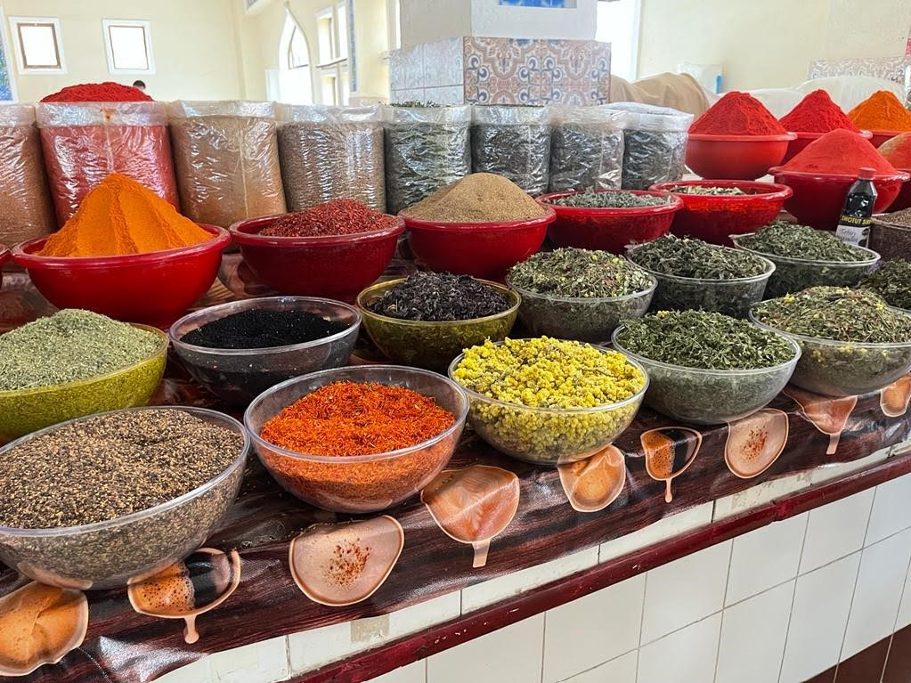
Visiting the Spice Bazaar
Credit: Andrew Guier
These videos provide a glimpse into the spice bazaars in Uzbekistan.
Bazaars are still where most people buy their everyday foodstuffs, including seasonings.
Bargaining is still a strategy used in buying goods at the bazaar today.
Merchants in Bukhara are world-renowned for their negotiation skills.
Spices are purchased in bulk and in grams.
VIDEO LINKS:
Mickey Marsee- Tashkent spice bazaar, June 2022:https://youtu.be/gs7ROXjT9z4
Visit to Bukhara spice bazaar: https://youtube.com/clip/Ugkx-nMe1YT7K2b9LL5IQDTrIabqijIaMsnd
Bazaar. Bukhara. Uzbekistan. Credit: Mickey Marsee

Slide 22
Homework
Using your notes from the class smelling experience, write two descriptive paragraphs: one for your favorite smell, and one for your least favorite.
Begin preparing to research with your group, one spice from Uzbekistan by reading the articles below on the spice trade along the Silk Road. They lay a basic foundation.
Write a one paragraph summary synthesizing what you learned about the spice trade from the articles.
Readings:
https://www.sciencedirect.com/science/article/pii/S2352618115000062
https://en.unesco.org/silkroad/content/did-you-know-exchange-spices-along-silk-roads
https://www.bbc.com/future/bespoke/made-on-earth/the-flavours-that-shaped-the-world/

Slide 23
Day 3: Spice Project
Objectives:
Identify for group project one of the spices from Uzbekistan
Research history and use of the spice/herb
Synthesize information into multimedia essay
Notes:
So this project obviously will take more then a day to complete; instructors can assign however many days they deem appropriate for research, drafting, workshopping and submission.

Slide 24
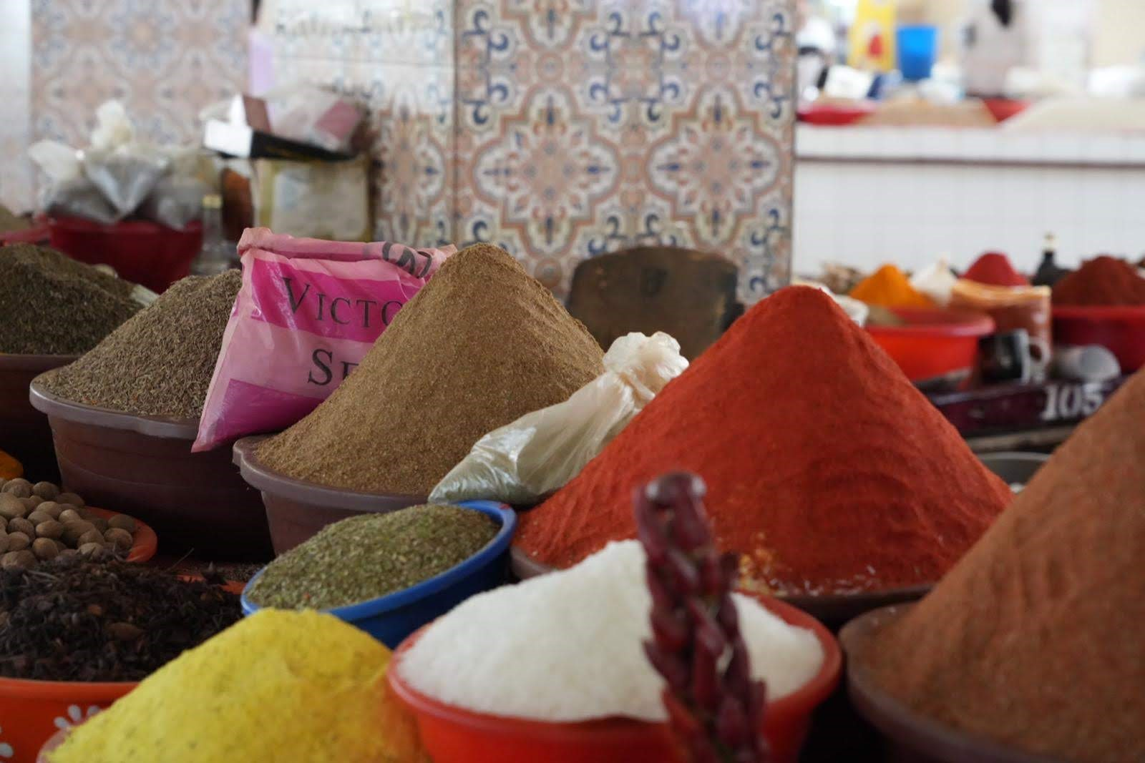
Bazaar. Tashkent. Uzbekistan. CREDIT: Andrew Guier
Review of readings:
How does an olfactory/ smell experience transport us in a history lesson or culture?
What can a spice or the spice trade inform us or reveal to us a place’s history?
To what extent do spices or the spice trade connect to the history and/or culture of Central Asia or Uzbekistan?

Slide 25
Multimedia Essay Assignment: History of Spice X in Uzbekistan
For this assignment, in groups of 3-4, you will create a multimedia essay using primary and secondary research to respond to the question: What surprising aspect of Uzbek history and culture does spice X reveal? (Spice X is the spice/herb your group selects from the smell experience)
Assignment requirements:
Focus on one spice and on Uzbekistan.
Incorporate a minimum of 3 media support pieces (e.g. image, podcast, documentary clip, YouTube clip).
Text should run approximately 750 – 1,000 words and include information about and description of the spice, its history, and its role in historic and contemporary Uzbek culture (can include economic aspects, culinary use, sustainability, globalization, etc.)
Citations/References in APA Format
Notes:
This assignment can take many forms: a report, a traditional essay, a wikipage, a podcast, a video. Part of scaffolding is to include their earlier work in describing the spice/herb in class exercise and synthesizing discussion of the role spices play overall.

Slide 26
Bibliography
Ancient Sumeria To Chipotle Tacos, Cumin Has Spiced Up The World: https://www.npr.org/sections/thesalt/2015/03/11/392317352/is-cumin-the- most-globalized-spice-in-the-world
Bembibre, C., Strlič, M. Smell of heritage: a framework for the identification, analysis and archival of historic odours. Herit Sci 5, 2 (2017). https://doi.org/10.1186/s40494-016-0114-1
Breaking News English Lesson: Historic Smells. https://breakingnewsenglish.com/2011/201119-historic-smells.html
Cook, S. (2018). Biodiversity and the future of farming. In The spice of life: the fundamental role of diversity on the farm and on the plate (pp. 10–18). International Institute for Environment and Development. http://www.jstor.org/stable/resrep16590.7
EastAsiaHK. (2020, June 9). Uzbekistan - Exclusive Performance of Doira va Raqs by Tara Pandeya and Abbos Kosimov [Video]. YouTube. https://youtu.be/-Sfdw3GjgFU
Eden, Caroline. (2021).Samarkand: Recipes & Stories from Central Asia & The Caucasus. Octopus Publishing Group.
Herz, R.S. (2002, 11 Nov). Do scents affect people's moods or work performance? Scientific American. https://www.scientificamerican.com/article/do-scents-affect-peoples/
Jenner, M.S.R. (2011). Follow Your Nose? Smell, Smelling, and Their Histories. The American Historical Review, 116(2), 335–351. http://www.jstor.org/stable/23307699
Khojimatov, O.K., et al. (2015). Some wild growing plants in traditional foods of Uzbekistan. Journal of Ethnic Foods, Vol. 2, Issue 1, Pages 25-28, https://doi.org/10.1016/j.jef.2015.02.005
Loewe, M. (1971). Spices and Silk: Aspects of World Trade in the First Seven Centuries of the Christian Era. Journal of the Royal Asiatic Society of Great Britain and Ireland, 2, 166–179. http://www.jstor.org/stable/25203290
MM Channel. (2021, Jan 11). The spice market at Bukhara, Uzbekistan [Video]. YouTube. https://youtube.com/clip/UgkxnMe1YT7K2b9LL5IQDTrIabqijIaMsnd
Patterson, Daniel. (2016, 26 Aug) “Spices, culture and the value of cuisine.” Medium. https://medium.com/@dcpatterson/spices-culture-and-the- value-of-cuisine-8581bebb3d3d
Ray, P. S. (2016). “Silk road economic belt and the 21st century maritime silk road: Effect on global supply chains and maritime connectivity.”Proceedings of the Indian History Congress, 77, 828–834. https://www.jstor.org/stable/26552712
Resource about a smell sensory project in Europe: https://odeuropa.eu/ with an excellent bibliography at: https://odeuropa.eu/publications/
Spengler III, R.N. (2020) The Silk Road Origins of the Foods We Eat. Central Asian Arecheobiology. https://robertnspengler.com/fruit-from-the-sands- the-silk-road-origins-of-the-foods-we-eat/

