Slide 1
Jordan's Water Crisis, Pt 2
Mr. Wolford’s Geography

Slide 2
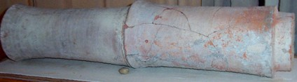
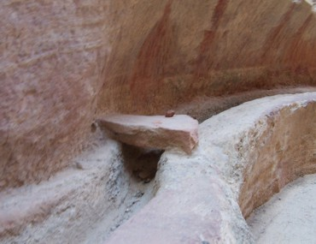
How Jordan Adapted in the Past
Jordanians have always understood that they have limited water, but for centuries they adapted:
Nabateans: As seen in Petra, the Nabateans constructed open-faced canals for spring water and rain water to allow people to wash their hands, animals to drink, and so on.
  They also carved reservoirs to allow clean water to flow to people in their cities

Slide 3
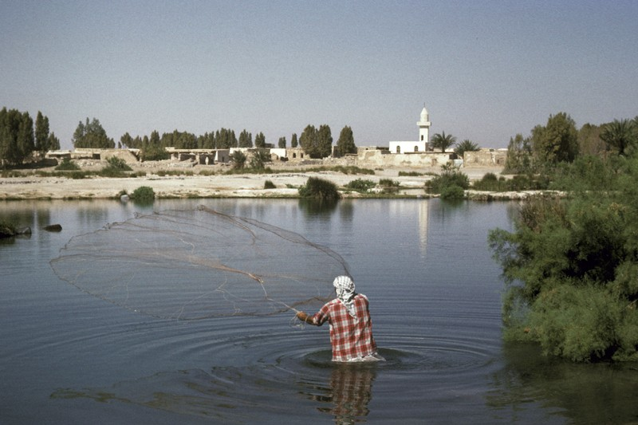
Man Fishing at a pool near Azraq, 1960s

Slide 4
The Dead Sea’s Decline
The Dead Sea has also been drying up, falling almost 100 feet in sea level

Slide 5
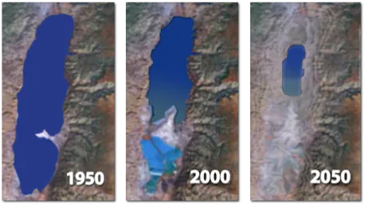

Slide 6
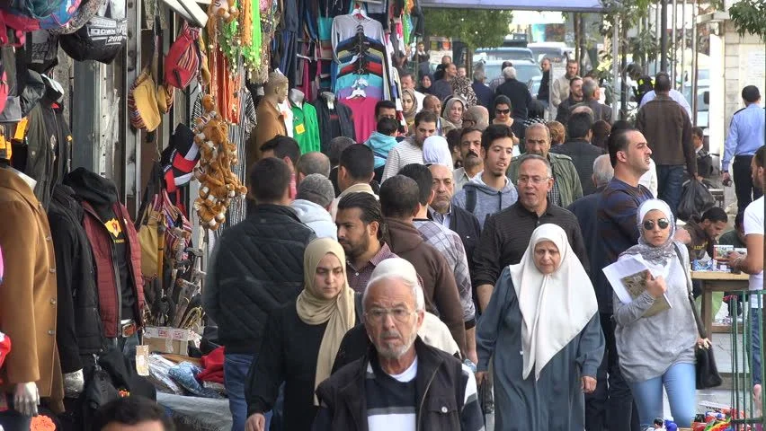
Increase in Population
Jordan’s population has also grown in the past few decades, partially because of the refugee population
Population in 1950: 438,386 (1.2 million including the West Bank)
Population in 1980: 2,216,903
Population in 2010: 6,931,258
Population in 2022: 11,285,869

Slide 7
What other water resources are available?

Slide 8
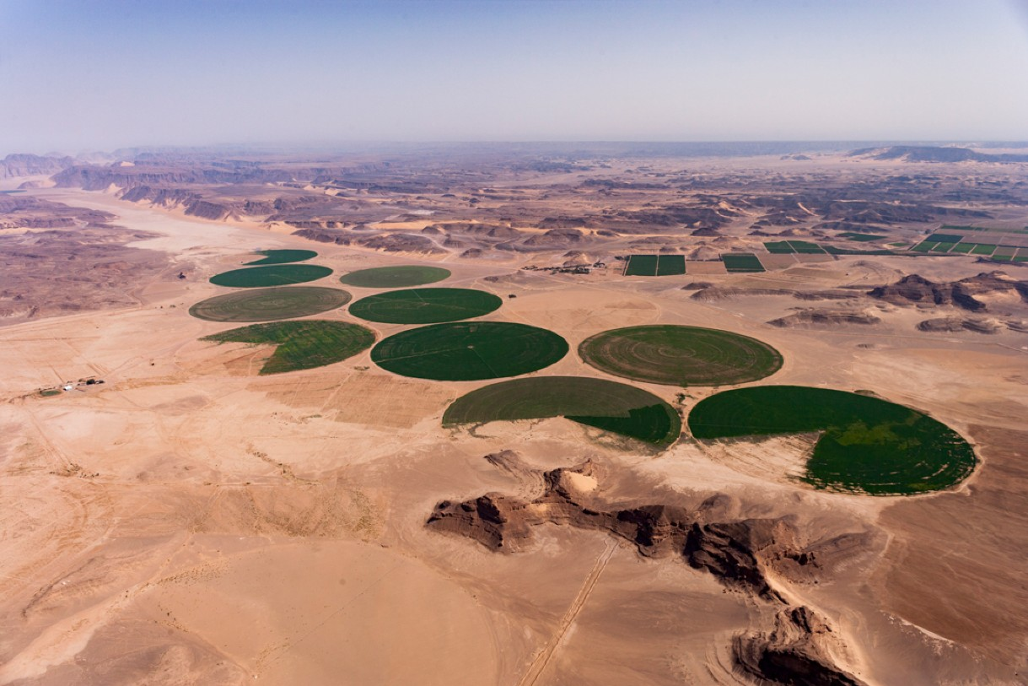
Aquifers
Aquifers are underground layers of rock or soil that contain water.
Jordan has a number of these in the North and South, including in communities like Azraq and Wadi Rum
Using irrigation, Jordan can bring this water to areas throughout the country
However, aquifers are drying up
  1990: Natural pools in Azraq dried up

Slide 9

Grey Water
Grey Water refers to water used by a household for purposes other than toilet water.
Used dish water
Shower water
Washing Machine water
It might not sound pretty, but you can recycle this water to be used for multiple purposes.

Slide 10
How can Jordan use these resources?

Slide 11
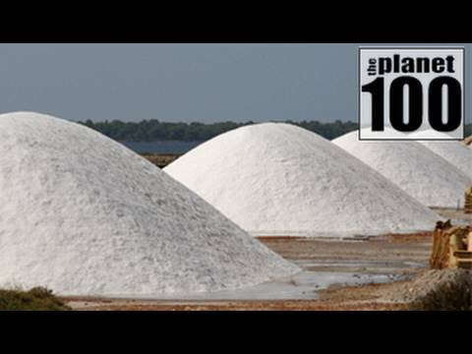
Desalination

Slide 12
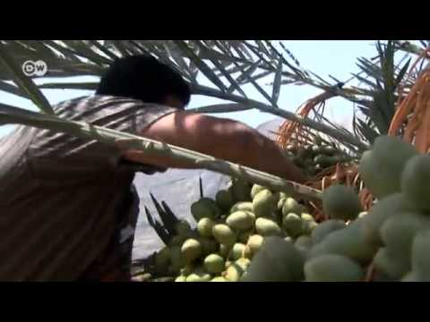
Greywater Recycling

Slide 13
Exit Slip
How might your water usage habits change if you lived in Jordan? How do you think you could personally adapt to it?

