Slide 1
Jordan's Water Crisis, Pt 1
Mr. Wolford’s Geography

Slide 2
Calculating Water Usage
Before we talk about Jordan’s present water crisis, we will spend the first few minutes calculating how much water you use in a day. This includes:
Drinking 1 cup of water: 0.24 L.
Shower: 9 L/min
Toilet: 4.9 L/flush
Food (Derived from Nature.com):
  To produce beef: 15,415 L/kg (or 867 L/taco)
  To produce chicken: 4325 L/kg (or 735 L/chicken leg)
  Lettuce: 7.5 L/Taco
  Tomato: 6.7 L/Taco
  Tortilla (And Cereal): 61 L/tortilla or bowl
  Milk: 255 L/glass
  Bag of Chips: 1292 L/bag

Slide 3
Calculating Water Usage
Now multiply this number by 365. How much liters of water did you use in a year?

Slide 4
The average Jordanian only has access to 100 cubic meters of water a year, or 100,000 L!

Slide 5
Why is water so Limited?

Slide 6
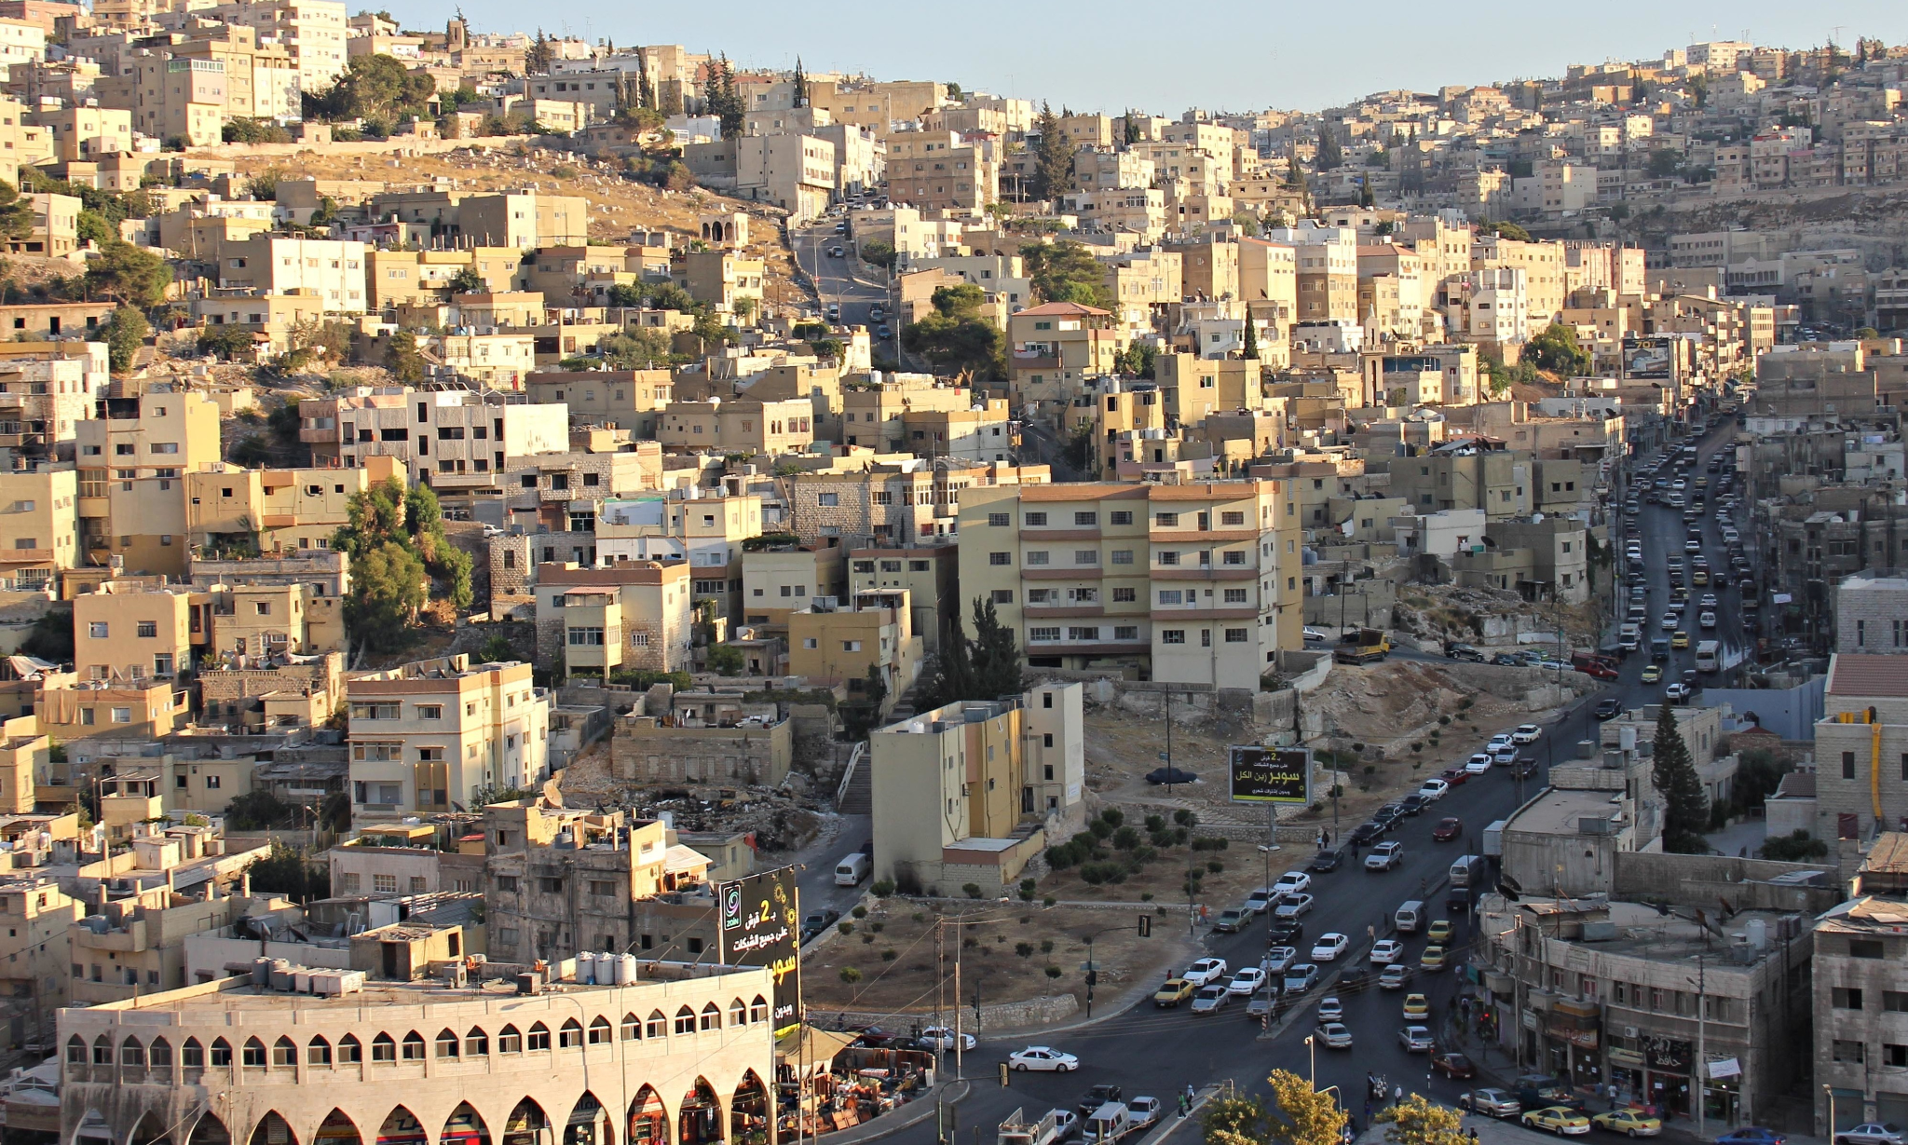
Jordan’s Environment
Jordan is classified as a desert, with hot temperatures and very little rainfall.
On an average year, Amman gets 9.6” of rainfall a year, mostly between December-March.
Summers often have no rainfall, period.
In places like Aqaba in Southern Jordan, it is likely that you only get 1” of rainfall a year.
Compare that to Unalaska, which gets around 34” of rain a year.

Slide 7
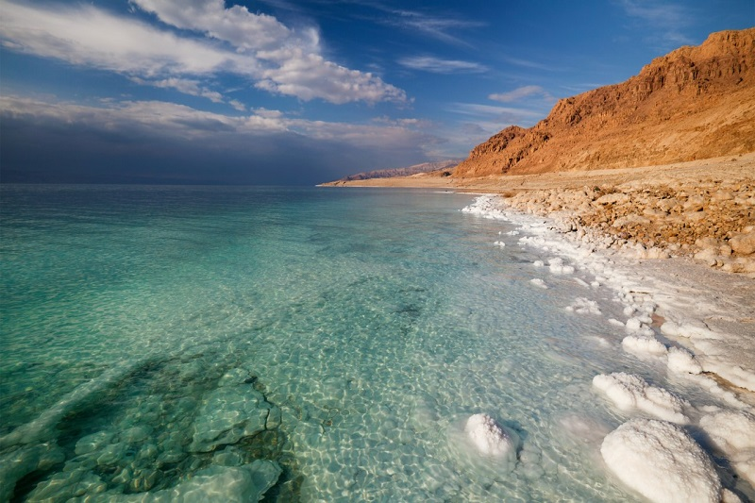
Bodies of Water
Seas: There are 2 saltwater seas (The Red and Dead Sea) with water that is not drinkable without desalination, or the ability to remove the salt from water.
Dead Sea: Located at the lowest elevation on land, the water in the Dead Sea is among the saltiest in the world, with 33.7% salinity (10 times saltier than the sea water in Unalaska)
The Dead Sea and Red Sea border other countries, including Israel, Saudi Arabia, and Egypt.

Slide 8
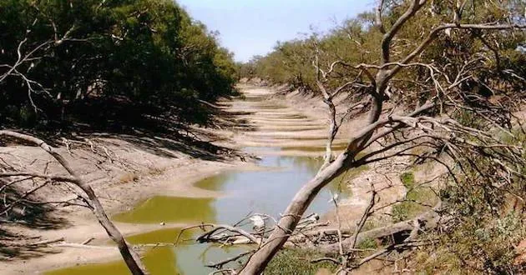
Bodies of Water
Jordan also has rivers, but those, like the Jordan River, have been drying up over the past few decades, partially due to people using the water for various needs.

