Slide 1
Jordan: An Abbreviated History, Pt 2
Middle School Geography

Slide 2
Classical Jordan

Slide 3
Jordan’s Roman Influence
Jordan became a part of the Empire when General Pompey conquered Palestine in 63 BCE.
7 of the 10 cities in the Decapolis (Gr: Ten cities) are a part of present-day Jordan
You can see remnants today scattered throughout Northern and Central Jordan.

Slide 4
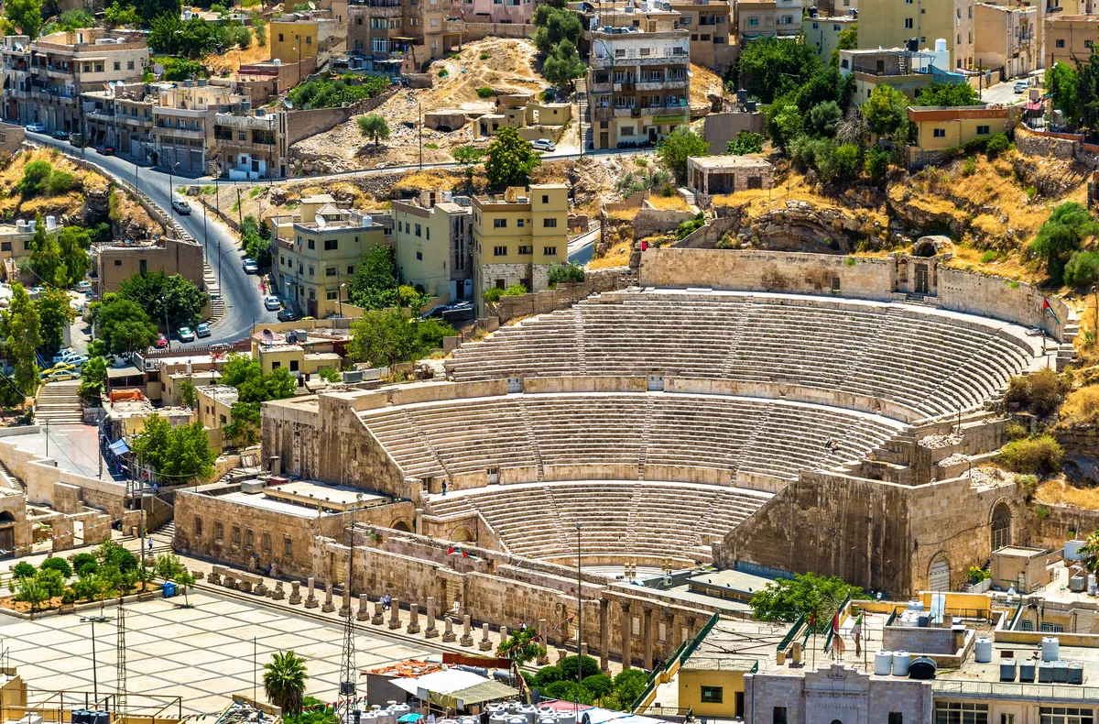
Roman Theater, Downtown Amman

Slide 5
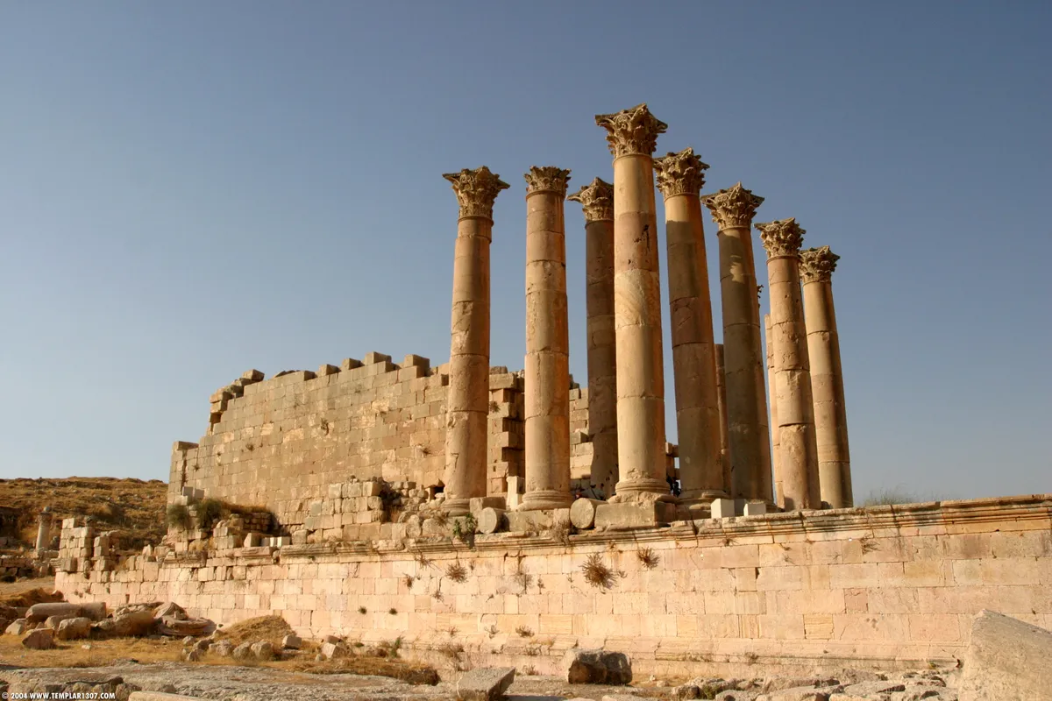
Temple of Artemis, Jerash

Slide 6
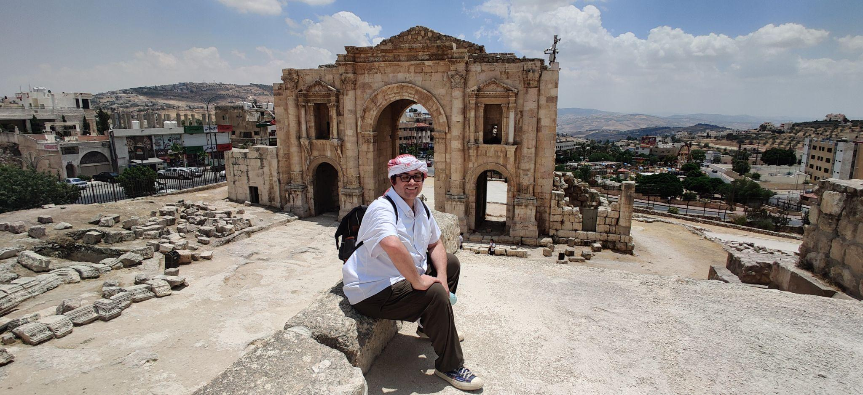
Hadrian’s Gate, Jerash

Slide 7
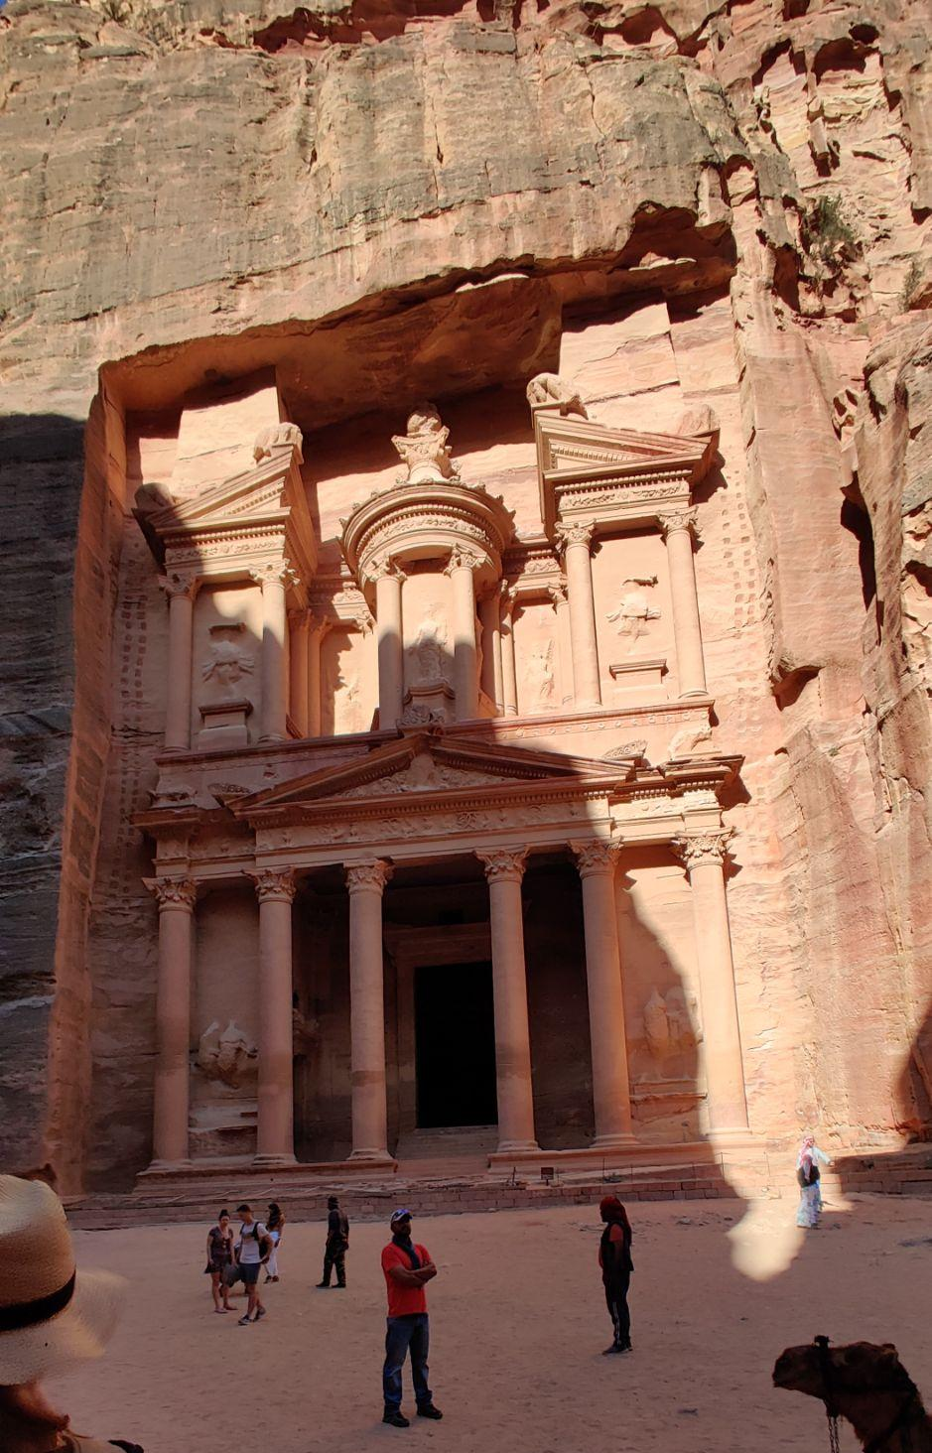
Is This Roman? (Petra, Jordan)

Slide 8
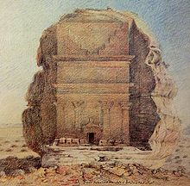
The Nabatean Kingdom
Existed between the 3rd Century BCE - 106 CE
Existed primarily in the Arabian Peninsula, in both present Jordan and Saudi Arabia
While they existed as a group prior to the 3rd Century (they resisted Antigonus I, one of Alexander the Great’s generals!), they officially became a Kingdom in the 3rd Century BCE
In its peak, it controlled much of the spice trade, including frankincense and myrrh
By 106 CE, Roman emperor Trajan brought it into the Roman Empire

Slide 9
Byzantine and Islamic Jordan

Slide 10
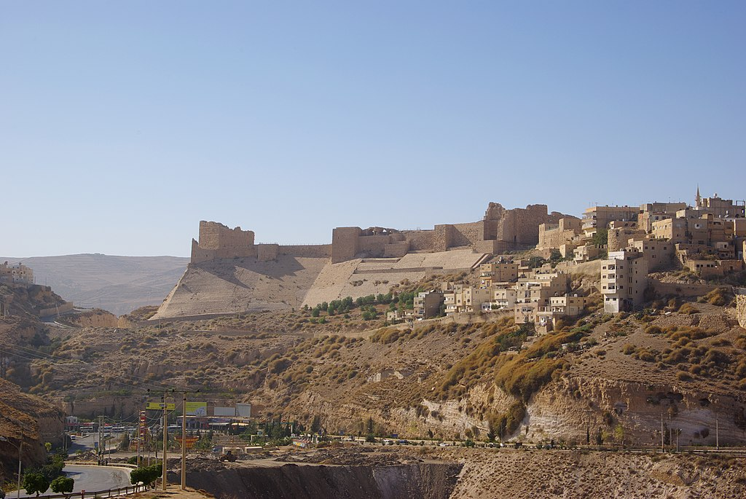
Byzantine and Islamic Eras
While Jordan was prominently Christian from the adoption of Christianity as the main religion of the Byzantine Empire in the 4th Century, by the 7th Century, it was occupied by Persia and later became a Muslim region.
Despite this, some ruins found in present-day Jordan include the Kerak Castle, which began as a Crusader Castle in 1142.
Likewise, the Ajloun Castle in Northern Jordan was a castle built by Muslims to fight against crusaders

Slide 11
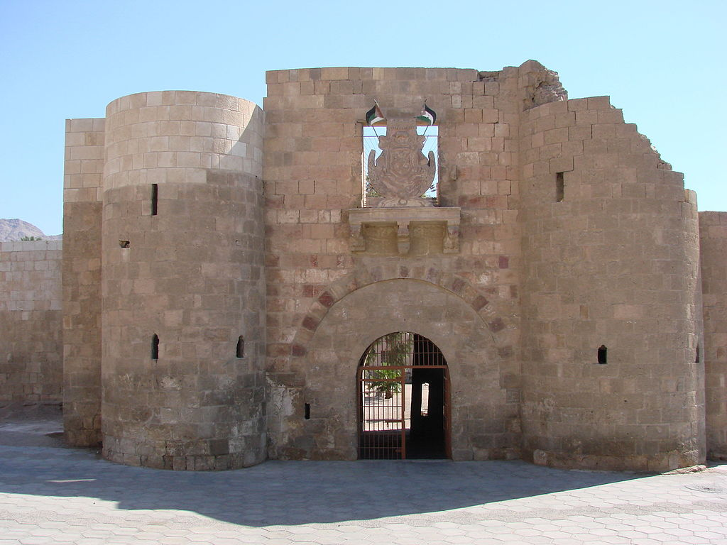
Ottoman and British Era
From 1516-1916, Jordan became a part of the Ottoman Empire.
Beginning in the 20th Century, upset by the Ottoman treatment of the Arab people, the Arabs (including those in Jordan) fought against the empire
This included the Battle of Aqaba in 1917, which took place while the empire was fighting in World War I
At the end of WWI, the British established Transjordan, led by Abdullah, first king of Jordan.
In 1946, the British declared Jordan an independent Country

Slide 12
Modern Jordan

Slide 13
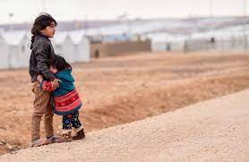
Jordan as a Refugee Nation
Starting after Israel’s war against Palestine in 1948, Jordan has had a prominent refugee population. This includes people from:
Palestine (Israel)
Iraq
Syria
Yemen
Most refugees come from foreign conflicts, including wars between Israel and Arab nations, the US’s War in Iraq, and Syria’s Civil War
According to the UN, over 760,000 people in Jordan are listed as Refugees, including 27,000 from Syria alone.

Slide 14
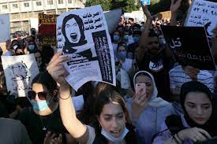
Human Rights in Jordan
While Jordanian citizens have many rights similar to the US, there are some limits:
Religion: You can have a faith other than Islam, but you can’t convert from Islam.
Speech: You can say almost anything, unless it is against the King or the military.
Women: While they technically have equal rights, they are still encouraged to follow many customs including wearing a hijab.
LGBT Rights: While they technically can live the way they choose to live, they cannot marry and are regularly discriminated against.
Tour Guide: “There are no gay people in Jordan.”

