Slide 1
The King’s Highway
Bronze Age Trade

Slide 2
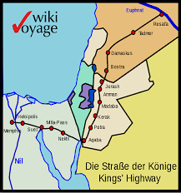
The King's Highway was a trade route of vital importance in the ancient Near East, connecting Africa with Mesopotamia.
On your map draw in the King’s Highway and the cities of Memphis, Aqaba, Jerash and Damascus. Label the Niles and Euphrates.

Slide 3
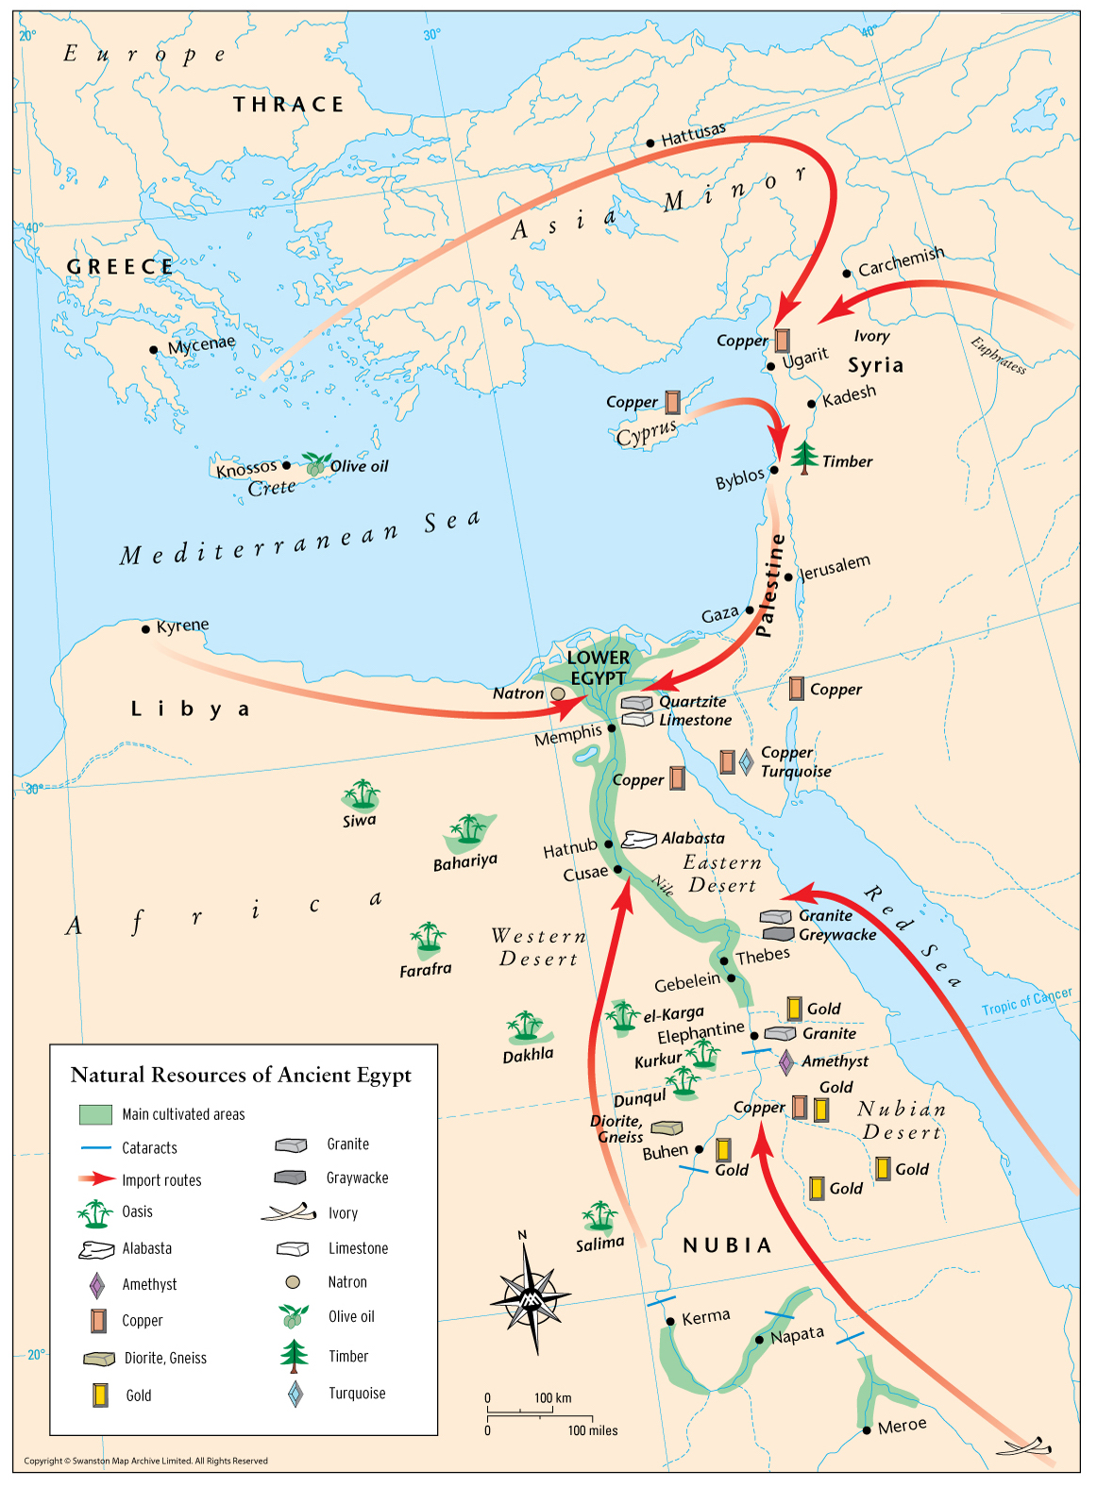
Resources from Egypt were sent north along the highway to trade for goods from Mesopotamia.
On your map label where gold, copper, timber, ivory and olive oil were found.

Slide 4
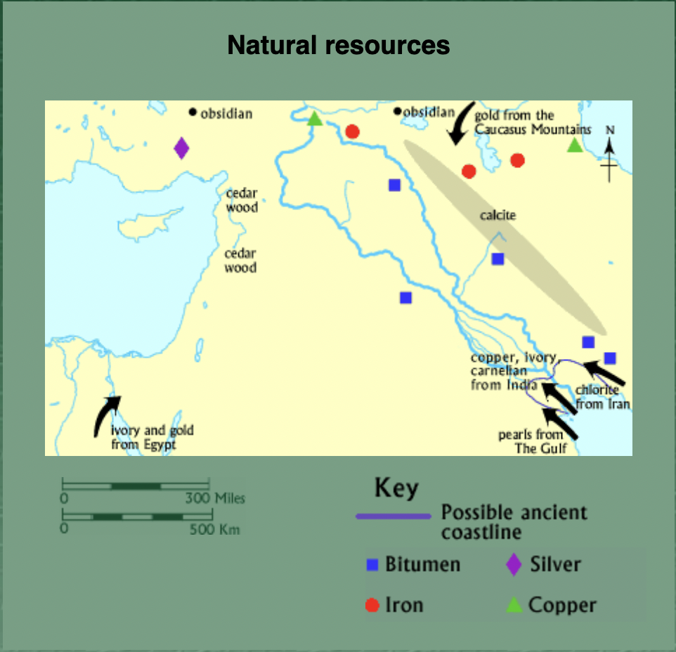
Add the natural resources found in Mesopotamia.

Slide 5
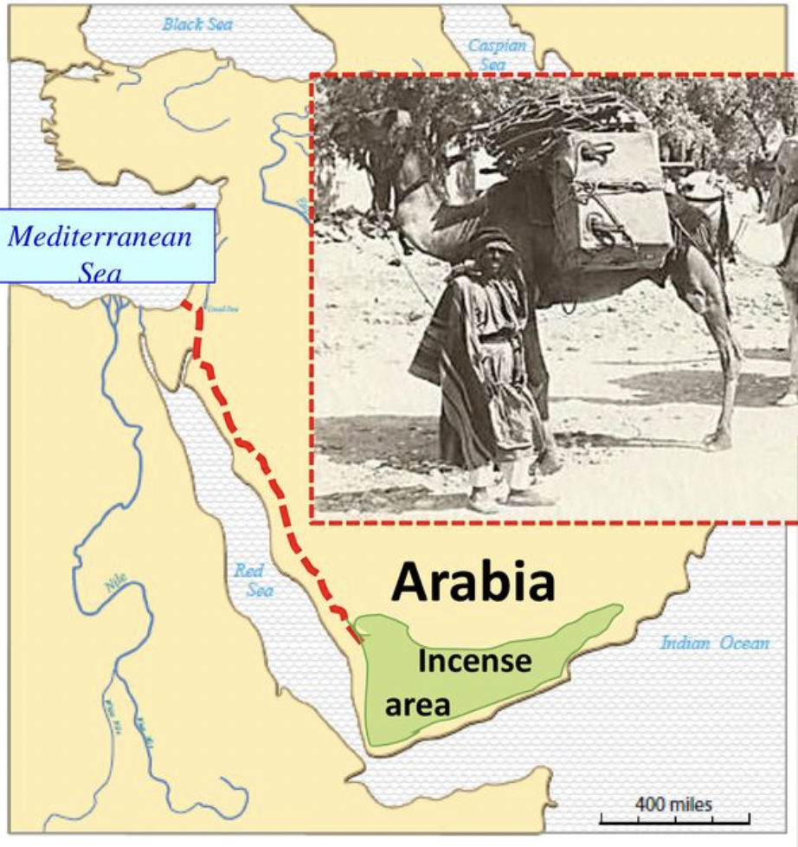
Frankencense
Add the area Frankencense is from on the map. Add the camel caravan route in dashed lines.

Slide 6
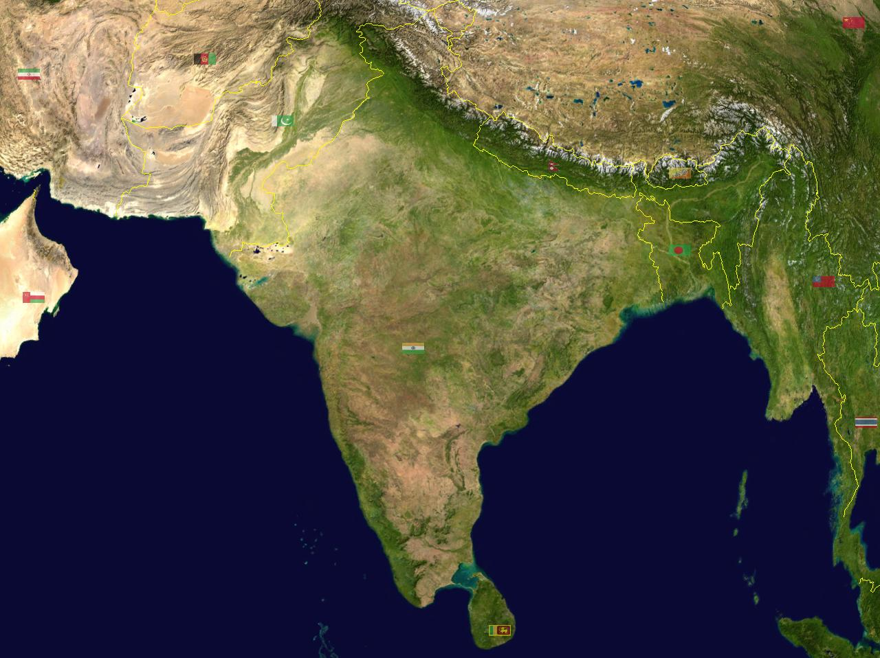
Lazuli, Lapis, Gold, Silver,Copper
Add the trade goods in India to the Map.
Pepper, Cardamon, Turmeric, Cotton Cloth

