Slide 1
Jordan: An Abbreviated History Pt 1
Middle School Geography

Slide 2
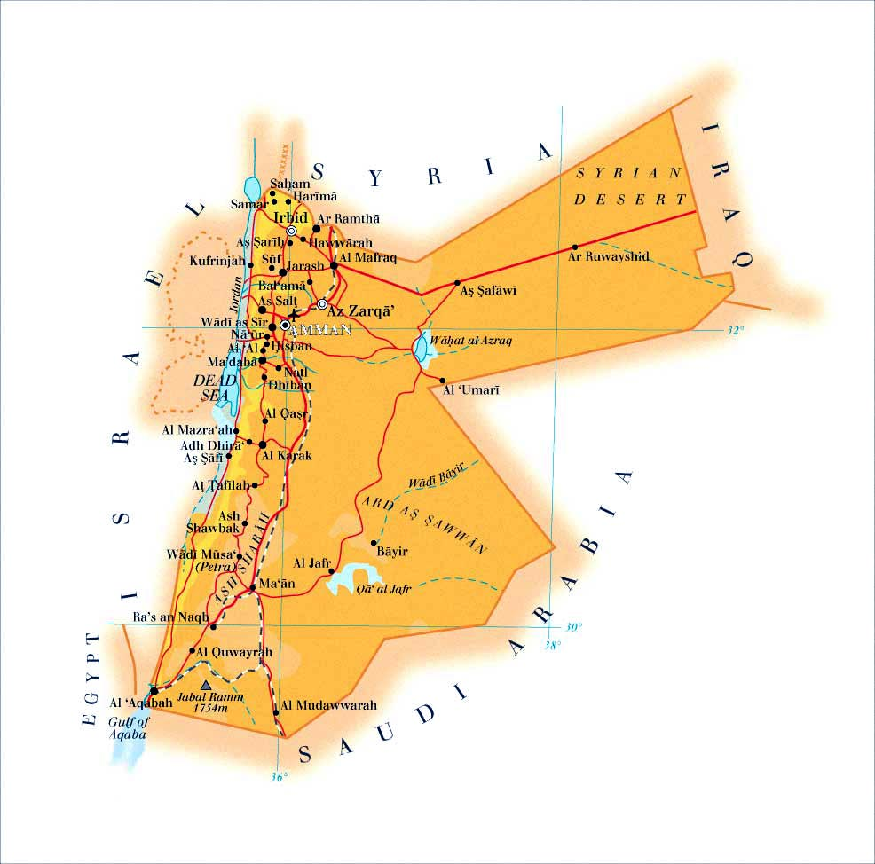
Introducing Jordan
Jordan is a country located in the Arabian Peninsula in Western Asia, bordering the following countries:
West: Israel and Egypt
North: Syria
Northeast: Iraq
South/East: Saudi Arabia
Climate: Arid Desert
Current Government was established in 1946 with the Treaty of Israel
Capital: Amman
Religions: Islam (97%) and Christianity (3%)

Slide 3
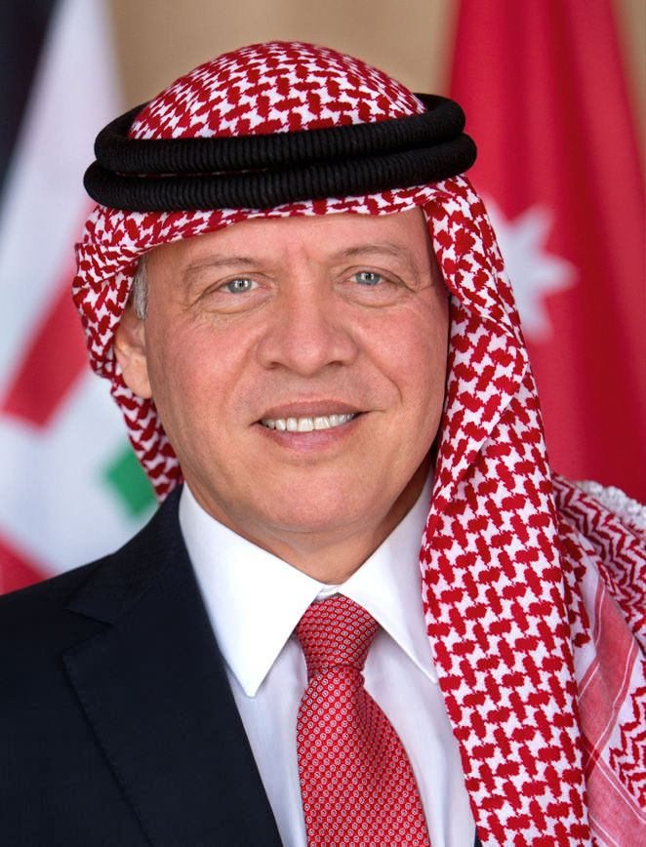
Jordan’s Government
Jordan is a Constitutional Monarchy with a Parliament
Ruler: King Abdullah II (Born 1962, Became King in 1999)
Prime Minister: Bisher Al-Khasawneh
Political Rights are similar to America, with some limits.
Money: Dinar (≈$1.50)

Slide 4
The History
While a fairly young nation, Jordan has a lot of history behind it
Of the Region

Slide 5
Biblical Jordan

Slide 6
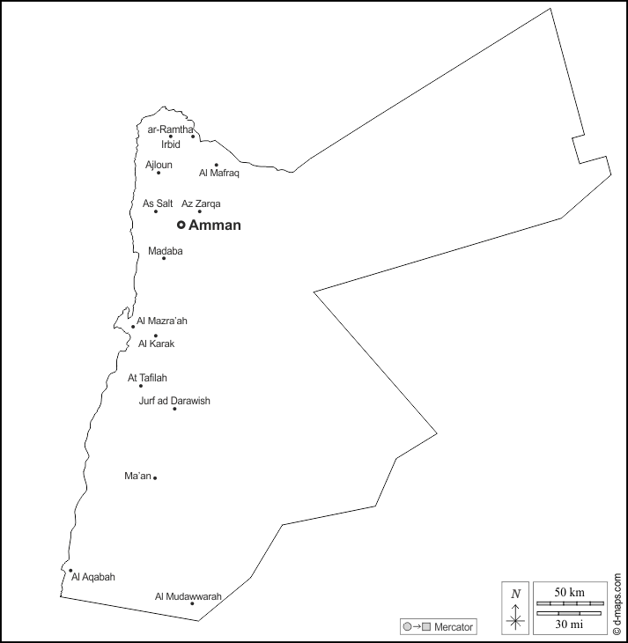
Ancient Jordan (approx. 13th Century - 400 BCE)
Ancient Jordan consisted of three groups of people:
North: Ammonites
Central: Moabites
South: Edomites

Slide 7
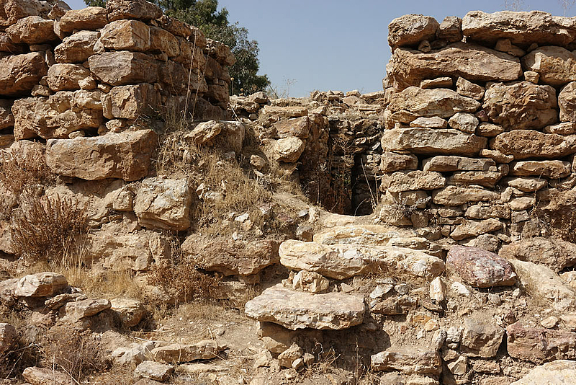
Ammonites
Established Around the 10th Century BCE
Capitol: Amman
Biblical Accounts described the Ammonites as the descendents of Lot and enemy to Israel.
In spite of living in an arid desert, most Ammonites lived in small communities managing farms and pastures.
Being a mountainous region, it was also a site for Sandstone and Limestone.
They made most of their money trading with other Jordanian kingdoms and Egypt on the King’s Highway, a road still in use today

Slide 8
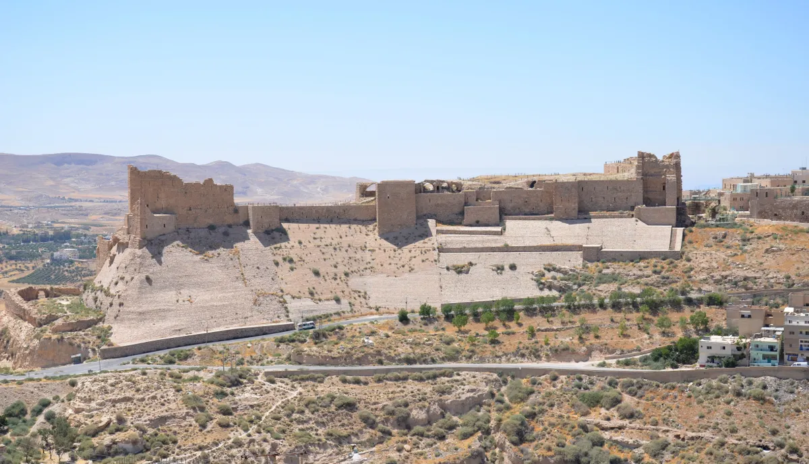
Moabites
Established in the 13th Century BCE
Capitol: Dhiban (Part of the Madaba Governorate)
Similar to Ammon, they particularly harvested grain and had access to mineral resources like copper and iron.
The region was quite mountainous, but also bordered waterways including the Dead Sea

Slide 9
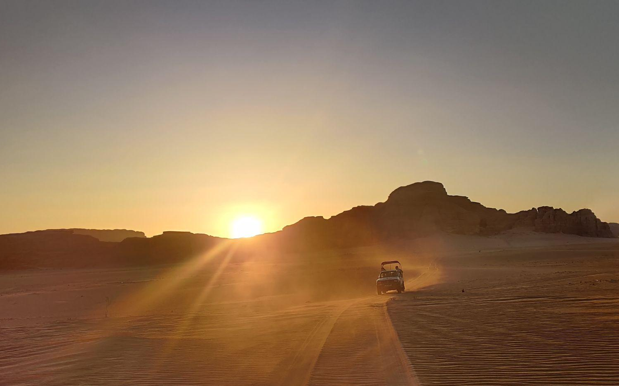
Edomites
Established in the 13th Century BCE
Capital: Bozrah (or Busaira)
As Southern Jordan has less farmable land than the rest of the country, trade was how the Edomites made most of their money.
Their trade routes extended as far as India

